Slide 1
Multithreading
Sun Certified programmer for java 6
Chapter 9

Slide 2
Threads
Multithreading allows a program to perform multiple tasks concurrently within a single process
Threads share access to memory
Execution of thread is an individual process (a "lightweight" process) that has its own call stack.
Applications:
User Interface Applications (GUI)
Web Servers and Application Servers
Online Banking and E-Commerce Systems
Games and Multimedia Applications
Operating Systems

Slide 3
Why do we need threads?
Better CPU utilization
Faster execution
Improved responsiveness
Resource sharing
Scalability
Prioritization

Slide 4
Example
Consider a simple web server - web server listens for request and serves it
If the web server was not multithreaded, the requests processing would be in a queue, thus increasing the response time and also might hang the server if there was a bad request.
By implementing in a multithreaded environment, the web server can serve multiple request simultaneously thus improving response time

Slide 5
Creating threads
In java threads can be created by extending the Thread class or implementing the Runnable Interface
It is more preferred to implement the Runnable Interface so that we can extend properties from other classes
Implement the run() method which is the starting point for thread execution

Slide 6
Running threads
class mythread implements Runnable{
public void run(){
System.out.println(“Thread Started”);
}
}
class mainclass {
public static void main(String args[]){
Thread t = new Thread(new mythread()); // This is the way to instantiate a thread implementing runnable interface
t.start(); // starts the thread by running the run method
}
}
Calling t.run() does not start a thread, it is just a simple method call.
Creating an object does not create a thread, calling start() method creates the thread.

Slide 7
Thread Scheduler
The thread scheduler is the part of the JVM (although most JVMs map Java threads directly to native threads on the underlying OS) that decides which thread should run at any given moment, and also takes threads out of the run state.
Assuming a single processor machine, only one thread can actually run at a time.
Only one stack can ever be executing at one time.
Thread scheduler that decides which thread, of all that are eligible will actually run.

Slide 8
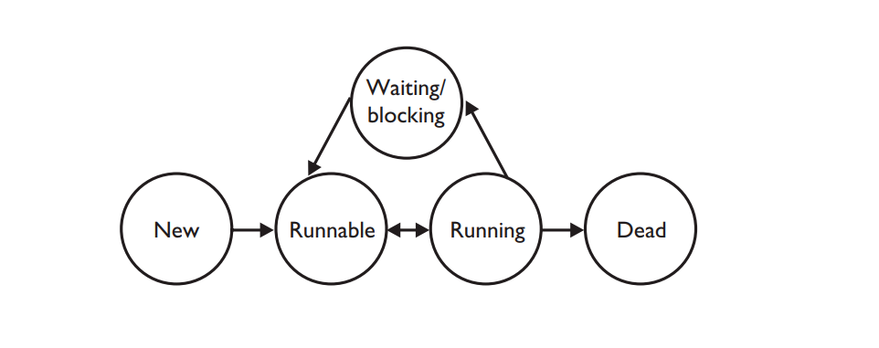
Thread States

Slide 9
Preventing Thread Execution
Sleeping
Waiting
Blocked because it needs an object's lock

Slide 10
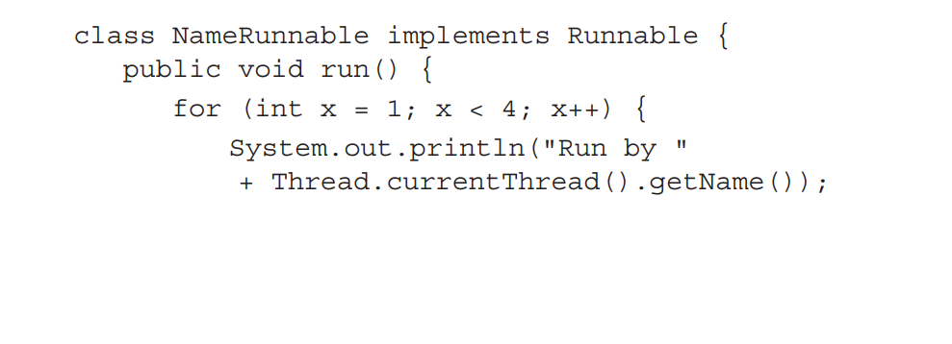
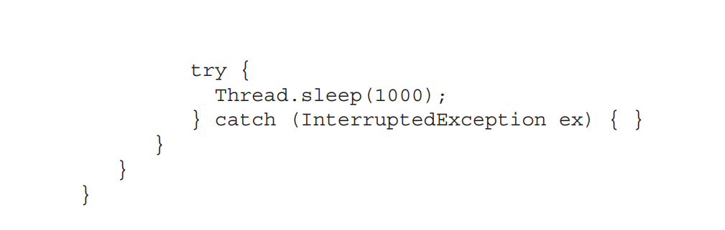
Sleeping

Slide 11
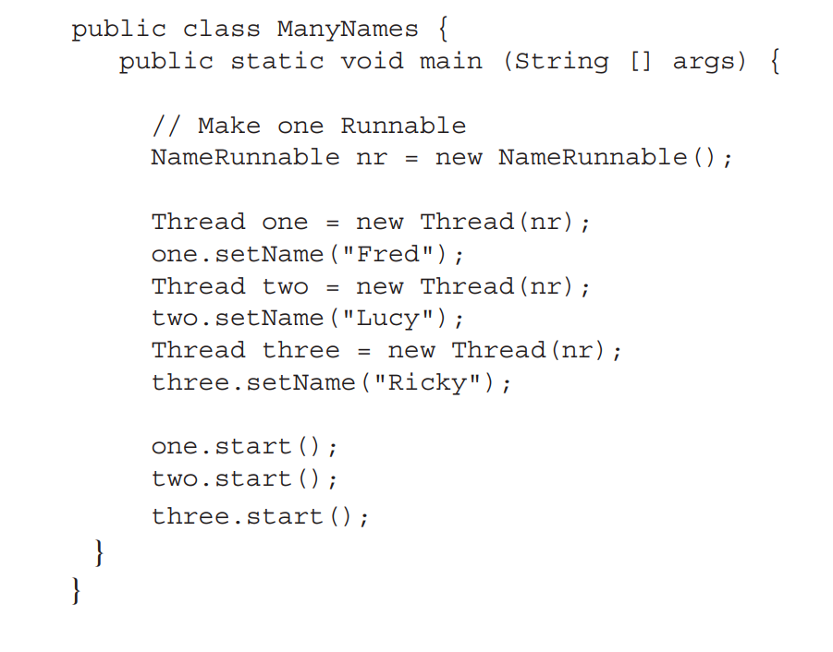
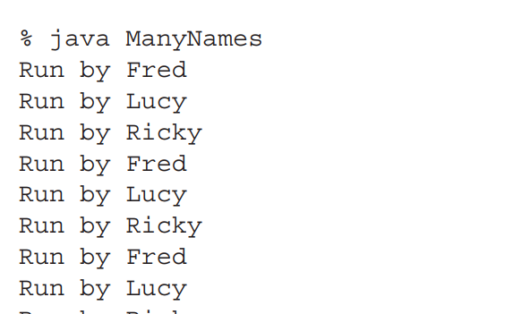
Sleeping
This output behavior is still not guaranteed.

Slide 12
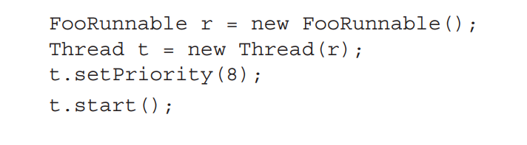

Setting a Thread's Priority

Slide 13
Java Thread Priorities
Thread.MIN_PRIORITY (1)
Thread.NORM_PRIORITY (5)
Thread.MAX_PRIORITY (10)

Slide 14
yield( ) Method
make the currently running thread head back to runnable to allow other threads of the same priority to get their turn.

Slide 15
join( ) Method
lets one thread "join onto the end" of another thread.
If you have a thread B that can't do its work until another thread A has completed its work, then you want thread B to "join" thread A.

